Slide 1
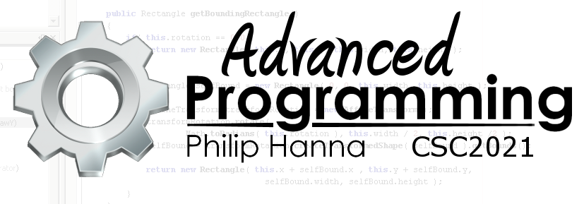
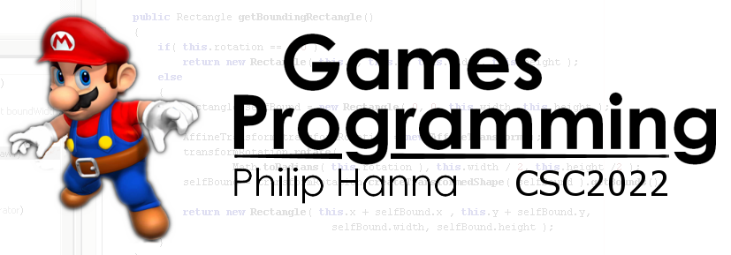
Debugging
General advice for debugging

Slide 2
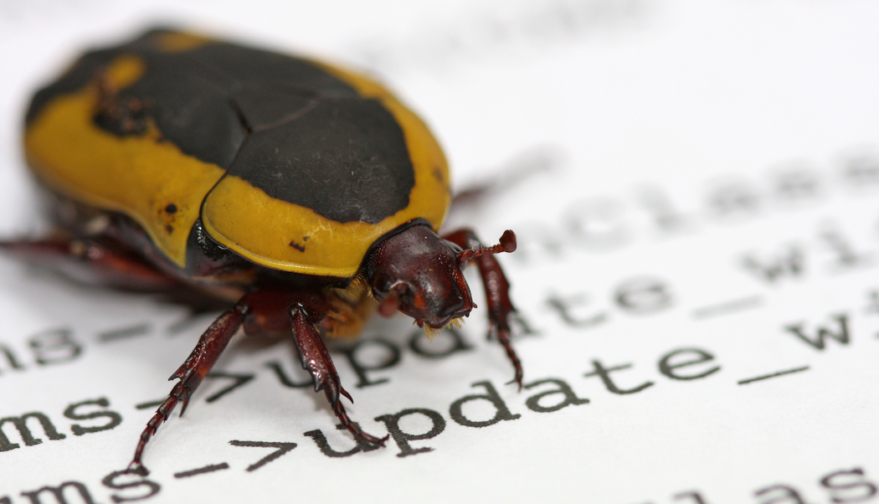
Debugging Advice

Slide 3

: In Games
Debugging in games is often hard:
Update/draw process happens very frequently and quickly (~50 times second, 20ms per tick).
It can be hard to reason about what is happening.
A lot of the available debugging tools cannot be easily applied to games (including GPU interaction)

Slide 4

The ten commandments of
debugging

Slide 5

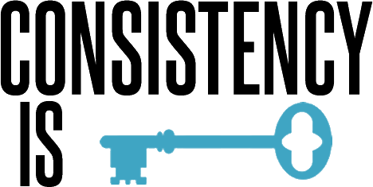
Thou shalt have a clear understanding of what should happen
This may be obvious, but some might start debugging without a clear understanding of what should happen.
Thou shalt reproduce the problem consistently
It is much easier to debug and test a problem that can be consistently reproduced, although sometimes this is not realistically achievable.

Slide 6

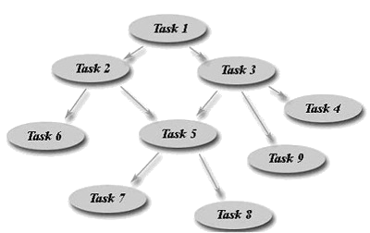
Thou shalt test your assumptions
Debugging is a process of identifying your assumptions (this can be hard) and then testing to see if they hold.
Thou shalt divide and conquer
In order to manage game complexity, ‘high-level’ assumptions should be firstly checked to enable the search to be constrained.

Slide 7


Thou shalt think and look
Debugging is a process of identifying an assumption and then checking the code (log file, debugger, print statements) to test that assumption.
Thou shalt change on thing at a time
When testing changes to a program, only one factor should be changed at a time to limit interdependency.

Slide 8


Thou shalt keep an audit trail
Using code versioning, keep a record of all changes made to the program
Thou shalt thoroughly test the correction
The correction should be tested to ensure the original problem has been fixed with no impact on existing working components.

Slide 9

Thou shalt not let the problem unfixed
Ignoring a problem only increases the new bug complexity and can introduce later problems or introduce dependency upon the buggy code.

Slide 10

Key takeaways:
A clear understanding of how the program should work is essential to effective debugging.
The reason for a bug is not immediately apparently, then a systematic divide-and-conquer approach where assumptions are identified and tested will usually work.

